Slide 1

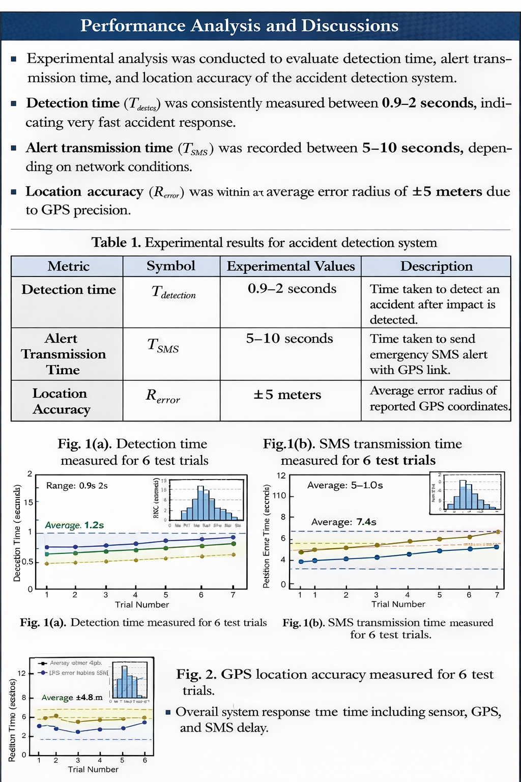
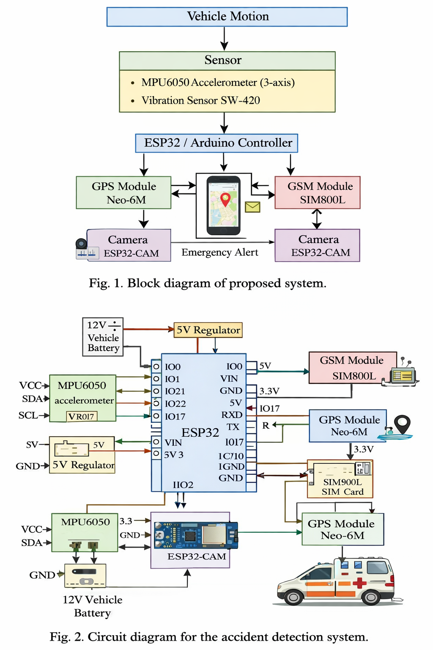

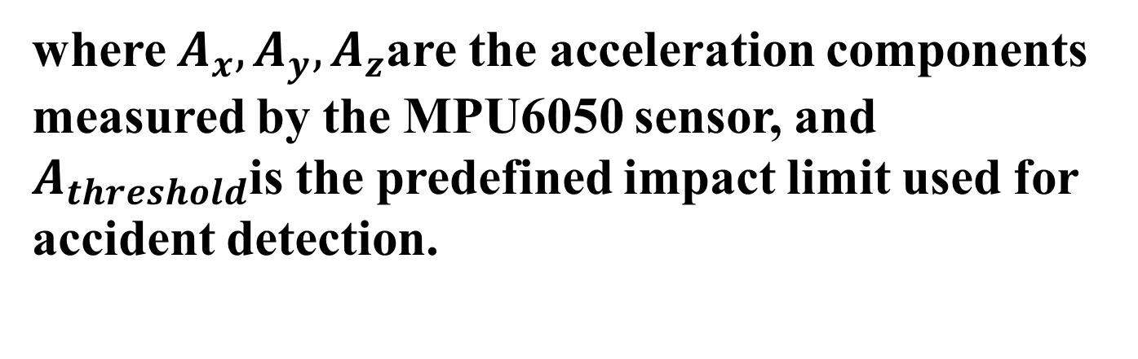
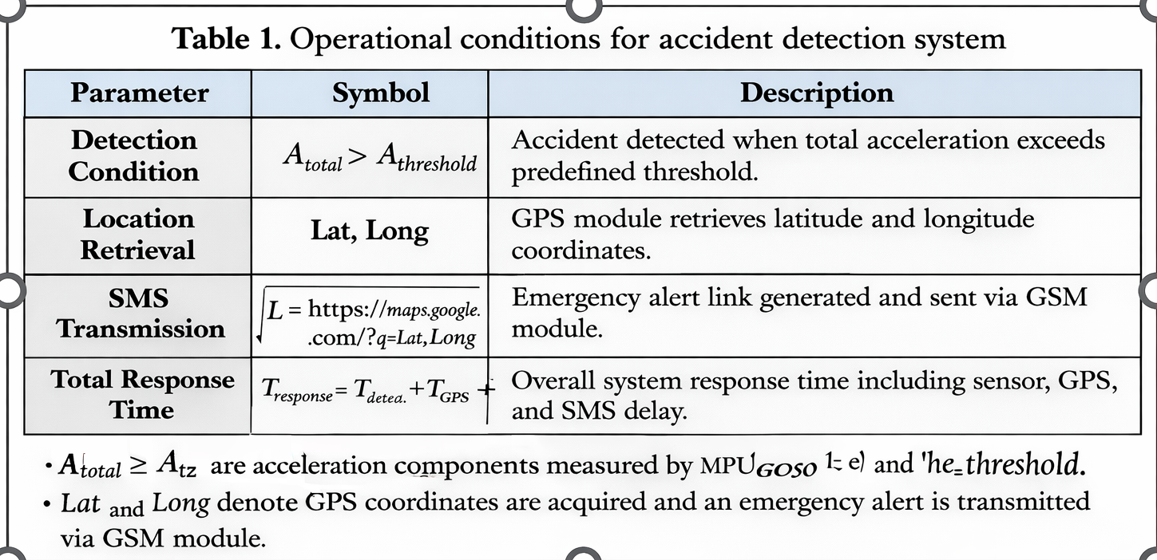
PROJECT TITLE (TNR 66)
Reg.No. (2310040106,2310040007,2310040126,2310049151),
Courses: Advanced Embedded Systems & Embedded Prototype
Electronics and Communication Engineering Department, Aziz Nagar, Hyderabad, Telangana, India
Supervised by
Dr. Joshitha C, Dr. S Sanjay, Mrs Madhavi and Dr Amit Srivastava
Abstract
Road accidents often result in delayed medical assistance due to lack of immediate reporting.
This project proposes an autonomous system for real-time accident detection using embedded and IoT technologies.
Sensors such as vibration sensor and MPU6050 accelerometer continuously monitor vehicle movement and detect abnormal impact or tilt.
Upon detecting an accident, the system automatically retrieves location coordinates using GPS.
An emergency alert containing the Google Maps link is sent via GSM module to predefined contacts and hospitals.
The ESP32-CAM captures real-time images of the accident site, ensuring faster response and improved road safety.
(a) (b)
Introduction
Road accidents are a major cause of injuries and fatalities worldwide, especially in developing countries.
Delay in providing medical assistance during the critical “Golden Hour” significantly increases the risk of death.
Traditional accident reporting depends on eyewitnesses or victims, which may not always be reliable. In remote or less populated areas, accidents often go unnoticed for a long time.
Advancements in Embedded Systems and IoT enable real-time monitoring and automated emergency communication.
Sensors such as accelerometers and vibration sensors can accurately detect sudden impacts or abnormal vehicle movement.
Integration of GPS and GSM modules allows automatic transmission of precise accident location details.
This project focuses on designing a low-cost, reliable, and autonomous accident detection system to improve road safety and emergency response time.
Rapid urbanization and increased vehicle density have made road safety a critical technological challenge.
Smart transportation systems require intelligent safety mechanisms that operate without human intervention.
The proposed system contributes toward building safer and smarter mobility solutions using real-time embedded monitoring and communication technologies.
(a) (b)
Proposed Shielded Geometry And Model
Conclusion
This section presents the design and working model of the Autonomous Accident Detection and Emergency Communication System.
The system continuously monitors vehicle motion using an MPU6050 accelerometer and vibration sensor. When sudden impact or abnormal tilt exceeds a predefined threshold, an accident is detected.
The controller immediately retrieves GPS coordinates and sends an emergency SMS via GSM module to predefined contacts. Simultaneously, the ESP32-CAM captures an image of the accident location.
The system operates autonomously without human intervention, ensuring faster emergency response during the critical golden hour.
The proposed Autonomous Accident Detection and Emergency Communication System provides a reliable and real-time solution for improving road safety.
The integration of accelerometer and vibration sensors enables accurate detection of collision events using a threshold-based algorithm.
The use of GPS ensures precise location tracking, while the GSM module enables immediate transmission of emergency alerts.
The ESP32-CAM enhances the system by capturing real-time images of the accident scene for better situational awareness.
The system operates autonomously without human intervention, reducing delay in emergency response. Experimental testing confirms fast detection time and reliable alert communication.
The proposed model is cost-effective, compact, and suitable for installation in various types of vehicles.
Overall, the system significantly reduces response time during accidents and has strong potential to minimize fatalities through timely medical assistance.
References
https://ijsret.com/wp-content/uploads/IJSRET_V12_issue1_237.pdf?utm
https://www.researchgate.net/publication/230799219_Automatic_Accident_Detection_Assistance_Through_Communication_Technologies_and_Vehicles
https://www.sciencedirect.com/science/article/abs/pii/S2214209615000625?utm
https://www.tandfonline.com/doi/abs/10.1080/03772063.2023.2239757?utm
https://ijsret.com/wp-content/uploads/IJSRET_V12_issue1_237.pdf?utm
https://ijarcce.com/wp-content/uploads/2026/01/IJARCCE.2026.15109-IoT.pdf?utm
https://ijrpr.com/uploads/V6ISSUE5/IJRPR47172.pdf?utm
https://demo.ijettjournal.org/archive/ijett-v67i8p211?utm
https://penerbit.uthm.edu.my/periodicals/index.php/eeee/article/view/10622?utm
https://res.ijsrst.com/IJSRST208735?utm
https://res.ijsrst.com/IJSRST208735?utm
https://www.mdpi.com/2079-9292/12/23/4829?utm
https://www.ijraset.com/research-paper/ai-and-iot-based-road-accident-detection-and-reporting-system?utm
https://matjournals.co.in/index.php/JORSGT/article/view/3255?utm_source=chatgpt.com
https://www.ijraset.com/research-paper/automatic-accident-detection-and-rescue-system?utm
16. https://penerbit.uthm.edu.my/periodicals/index.php/eeee/article/view/10622
17. https://www.ijraset.com/best-journal/smart-road-safety-and-emergency-response-system
18. https://www.mdpi.com/1424-8220/22/6/2077
19. https://www.mdpi.com/2071-1050/17/14/6510
Fig. 1. The geometry of passive shielded Cu/MLGNR interconnect.
Table 2. Parasitics expression for ESC model of MLGNR Interconnect
Fig. 2. An ESC model of shielded MLGNR interconnects.

